Slide 1
computer Vision and Generative AI-Based Code Generation System
Project Report | CSC-528
Team: Vasanthkumar Ramamoorthi- 2171863
Akash SAMPATH- 2147087
Arul MICHAEL ANTONY Felix Raja- 2133065

Slide 2
Abstract
Developed a hybrid AI system that generates structured HTML/CSS code from UI screenshots. Combines computer vision for layout analysis and a fine-tuned Mistral LLM for code generation.

Slide 3
Introduction
Manual Effort in UI Conversion: Frontend development often requires developers to manually translate UI/UX designs into HTML/CSS code, which is time-consuming and error-prone.
Automation with AI: Our project leverages computer vision and generative AI to automate the design-to-code conversion process, reducing manual workload.
Role of Computer Vision: Classical computer vision techniques like grayscale conversion and edge detection help extract layout and structural features from UI images.
Use of Language Models: A fine-tuned Mistral-7B large language model is used to convert processed visual layouts into structured HTML/CSS code.
Efficiency and Scalability: This hybrid AI system improves development speed, ensures consistency in design implementation, and paves the way for scalable UI prototyping.

Slide 4



Problem Statement
Objective: Convert UI screenshots into HTML code. Approach: Use CV to analyze layout, then LLM for code generation. Reduces manual coding, speeds up prototyping.

Slide 5
Method: Data Preparation
Used WebSight and Fluent-Dev from Hugging face datasets containing UI screenshots and their corresponding HTML/CSS code for fine-tuning.
There was about 2 million datas of screenshots and html code.

Slide 6

Computer Vision Preprocessing
1. Grayscale Conversion: Reduces image complexity, used open cv’s Color function.
2. Edge Detection: Highlights structural layout elements for the model to interpret, used canny edge detection algorithm.

Slide 7
Language Model Fine-Tuning
Model: Mistral-7B fine-tuned using QLoRA.
Efficient method using quantized layers and adapters. Allows training on commodity GPUs.

Slide 8
Inference Pipeline
Processed UI image is passed to the trained model.
Model generates HTML code saved in output directory.
Code is visually aligned with input design.

Slide 9
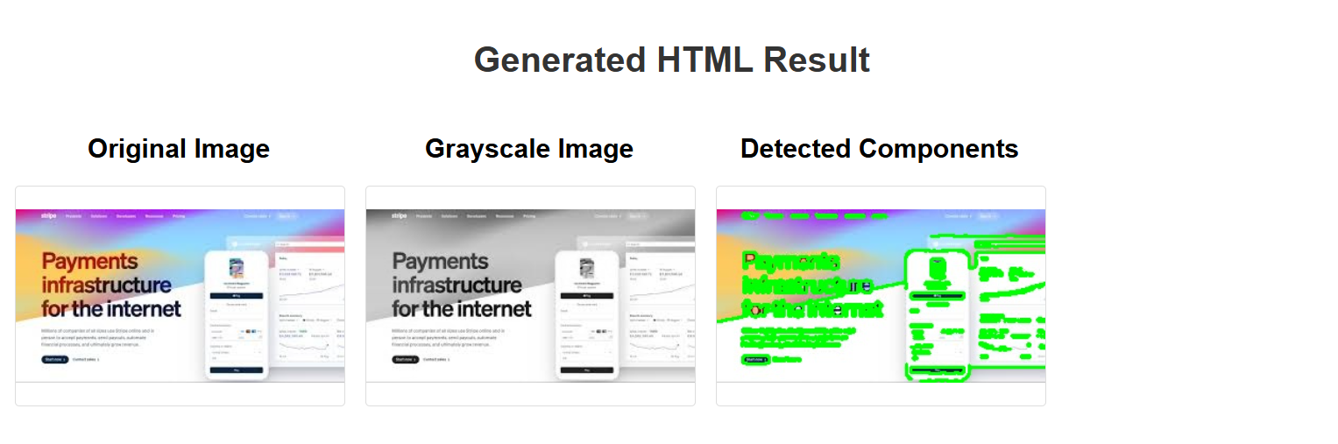
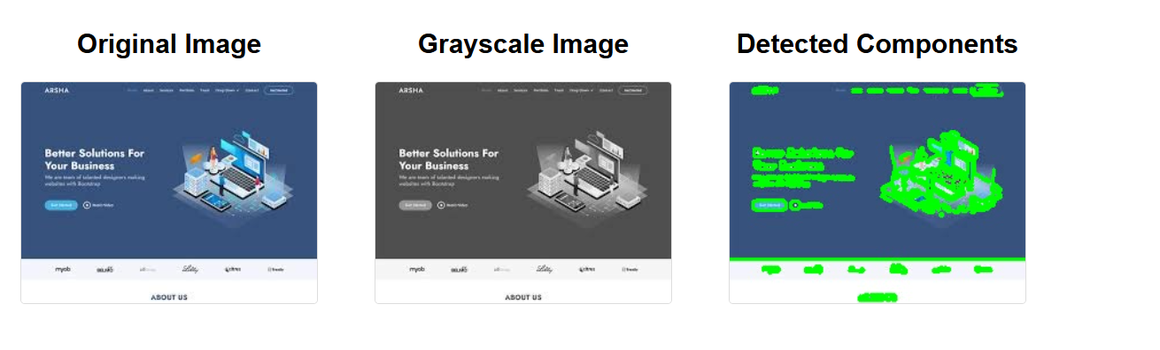
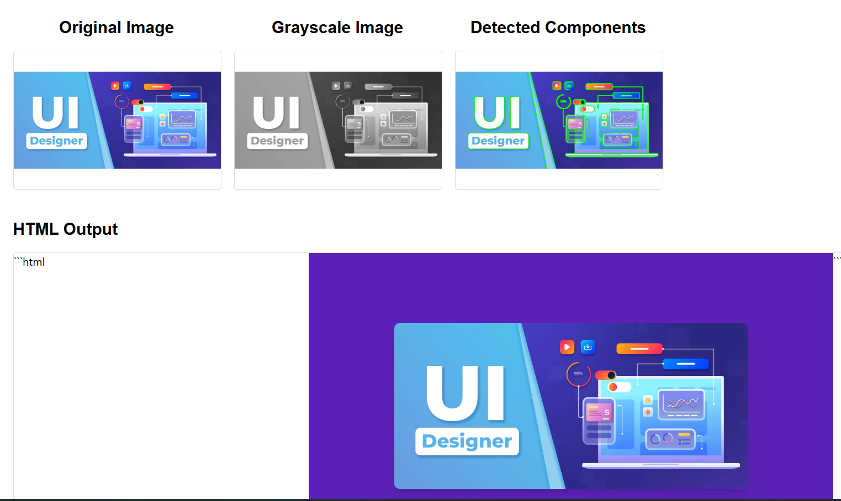
Sample Output

Slide 10
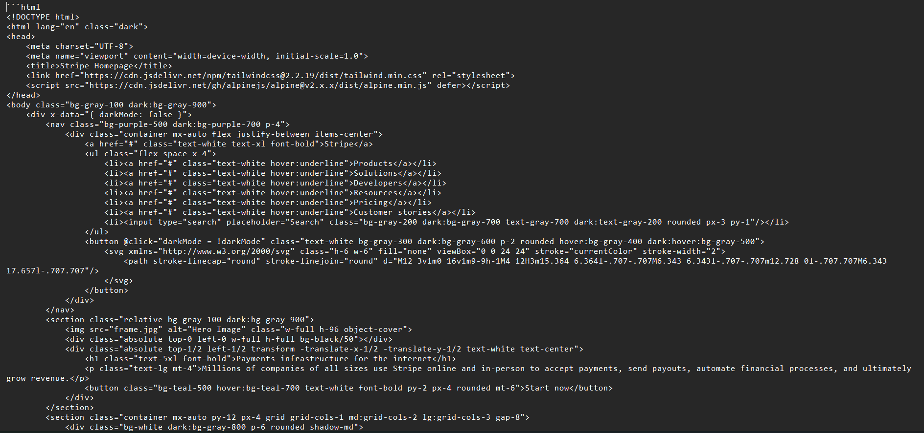
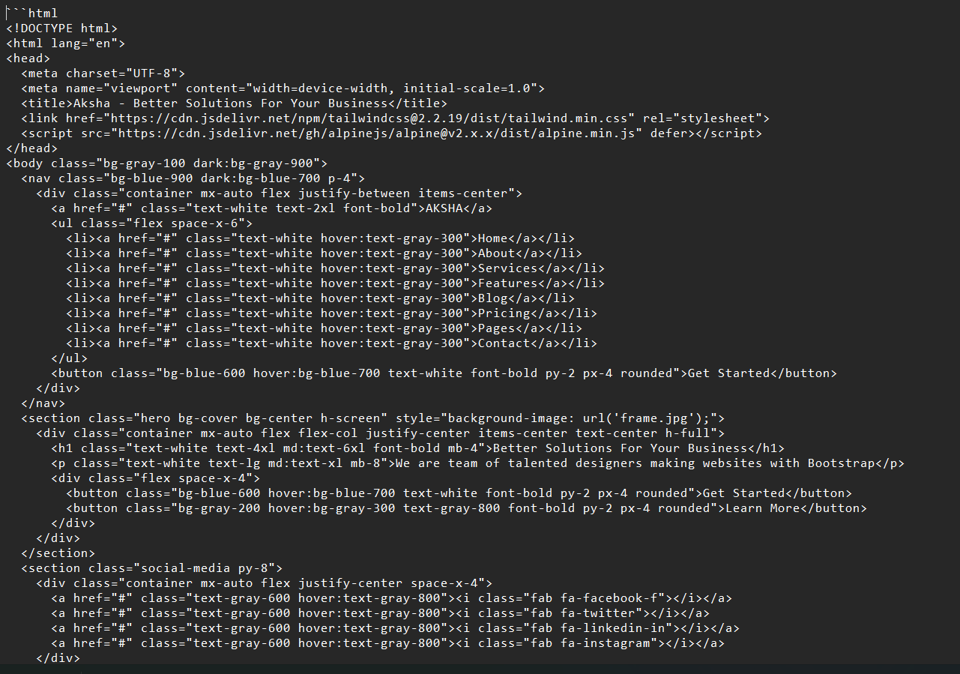
HTML CODE GENERATED

Slide 11
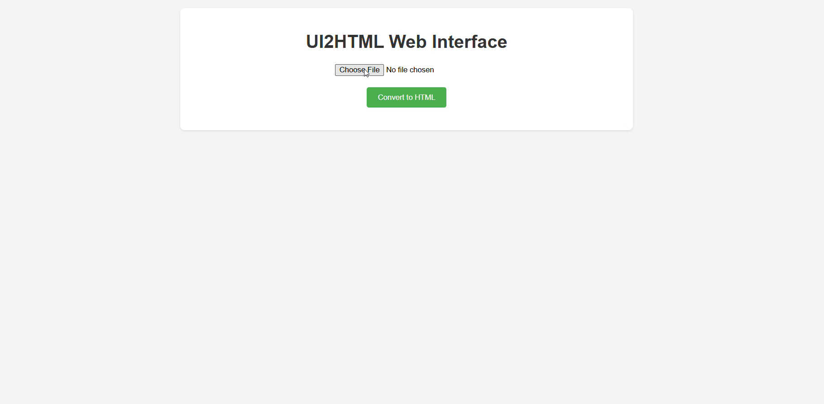
DEMO VIDEO

Slide 12
Conclusion
Demonstrated end-to-end automated design-to-code conversion.
Grayscale and edge detection enhanced layout understanding.
Mistral-7B fine-tuned using QLoRA mapped layout to HTML.
Foundation for future visual programming and design automation.

Slide 13
UPDATES FROM FEEDBACK OF PAPER
In this project, the loss function we used is CrossEntropyLoss, which measures the difference between the predicted HTML token distribution and the actual tokens.
A decrease in loss from 2.9 to 1.2 over 3 epochs indicates the model is learning to generate more accurate HTML code.
Training for more epochs might reduce the loss further, leading to improved code quality, but overfitting becomes a risk if the model starts to memorize instead of generalizing also it worked pretty well with 3 epochs. We planned to train it more and make it as a more accurate model as a future work.

Slide 14
.
Canny Edge detection to Mistral-7B Encoding:
The transition from edge-detected images to LLM input is crucial.
This step involved are:
Extracting geometric and textual features from edge maps
Converting these to tokenized prompts
Feeding structured layout prompts into the Mistral model

Slide 15
THANKYOU
.

